Slide 1
Summary of an initial model on U.S. incarceration rates
Michelle Tschida
7/2015

Slide 2
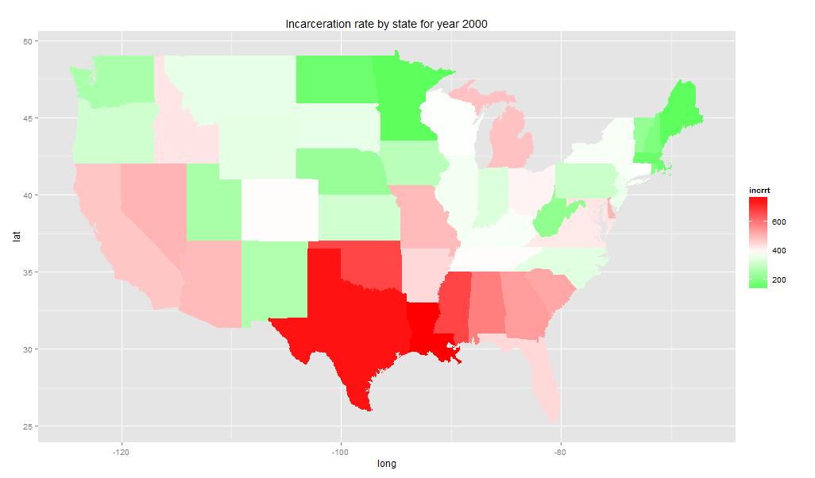
Overview
The Incarceration rate is the number of people in prison per 100,000 people.
There is state to state variability in incarceration rates.
Some states seem are more (or less) ‘tough on crime’. Texas is a classic example.
Are they tougher on crime or do they just have different circumstances.
U.S. incarceration rates by state for the year 2000.
Goal: Model U.S. state and year incarceration rates with the non-regional variables.

Slide 3
The data
The data was scraped from several sources on the web
Code is in R program called “Importing US incarceration and execution data .Rmd”. The author is Michelle Tschida.
The final data set:
Data Frame with 1750 rows and 80columns.
1750 = 50 states * 34 years
34 years from 1978 – 2012
Data by year and state
Incarceration rates (rate per 100,000 people)
Executions
Crime Rates
State Demographics (snapshot in time)
U.S. census bureau data “quick facts”, mostly around 2010.
R state data

Slide 4
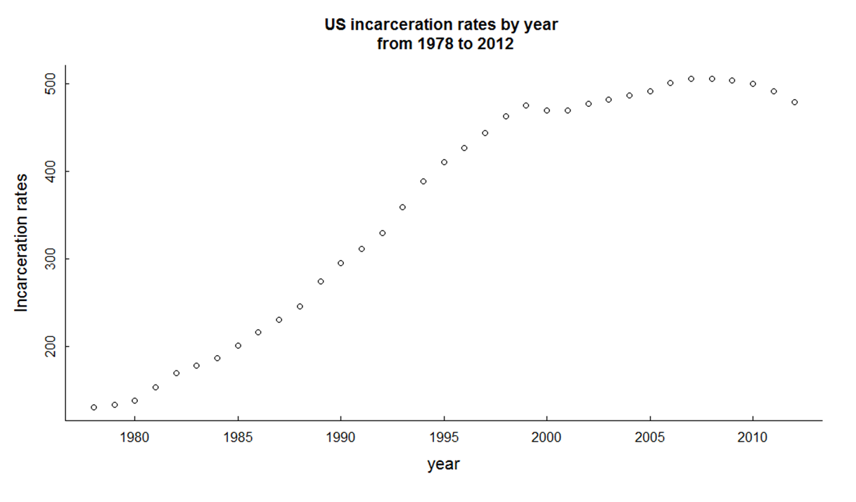
The data, slide 2
Crime Rates
U.S. incarceration rates from 1978 to 2012
The violent crime rate
murder and non-negligent manslaughter rate
forcible rape rate
robbery rate
aggravated assault rate
The property crime rate
burglary rate
larceny theft rate
motor vehicle theft rates
The crime rates are based on reported crimes in the U.S.
The crime rates are considered representative of the crime in the area.
Rates are the number of reported offenses per 100,000 population.

Slide 5
Variable reduction and data prep
Step 1. Reduce independent variables from 79 to 16. The main techniques were:
Remove all state and regional variables
Reduce redundant and highly correlated variables
Remove variables with a low correlation with incarceration rate.
Choose initial crime variables
Step 2. Data Prep
ln(incarceration rate)
heteroscedasticity – the residual ploy against y was funnel shaped
All Independent (x) variables except for year were standardized.
To compare the relative importance of variables on different scales.
Log Y and X -- a one unit increase in X would lead to a β∗100 % increase/decrease in Y
Log Y and standardized X -- a one standard deviation increase in X would lead to a β∗100 % increase/decrease in Y

Slide 6
Modeling: Step 3. Model selection
Generalized Additive Mixed Model (R package mgcv::gamm).
The 16 independent variables were kept and eliminated was based on
p-values, the AIC, the BIC , my understanding of the data/ what made sense (the art)
Something like backward selection was used
The final model
4 final Variables: year, violent crime rate, property crime rate, % living below the poverty level
ln(incarceration rate)~ 5.5093153 + f(year) + 0.023* violent.crime.rate - 0.043* property.crime.rate + 0.234* (% below poverty) - 0.017(poverty* violent.crime.rate) + AR(1)
state is a random variable
There is a time autocorrelation with lag 1 AR(1)
Year is a spline function

Slide 7
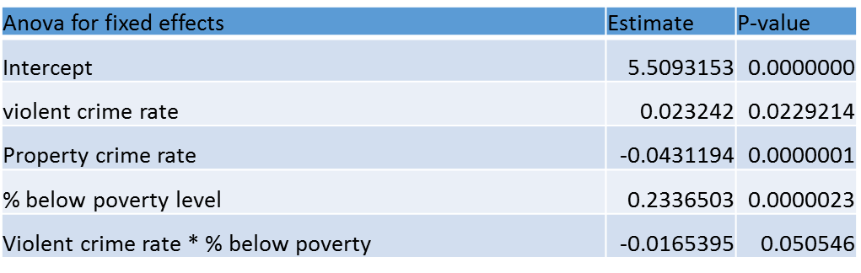
The final model: observations
R^2 = 60%
About 60% of the variation in state incarceration rates can be explained with my model of 4 variables (year, violent crime rate, property crime rate, % below the poverty level).
States with higher violent crimes tend to have higher incarceration rates.
The % of people living below the poverty level is a stronger predictor of incarceration rates than the reported crime rate.
The property crime rate has a negative coefficient in this model.

Slide 8
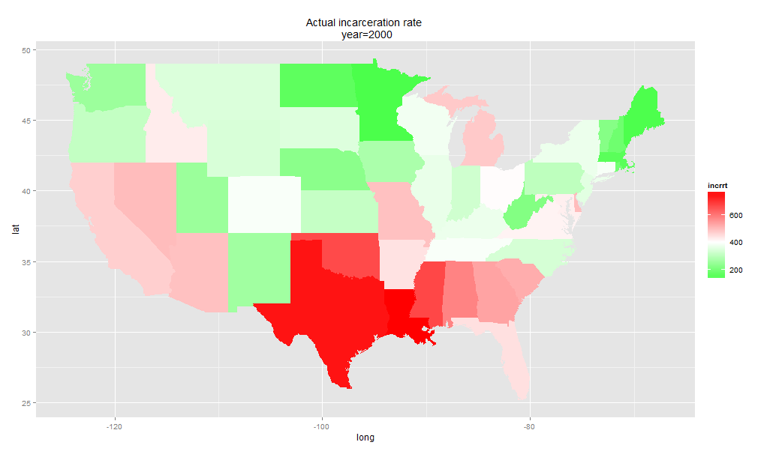
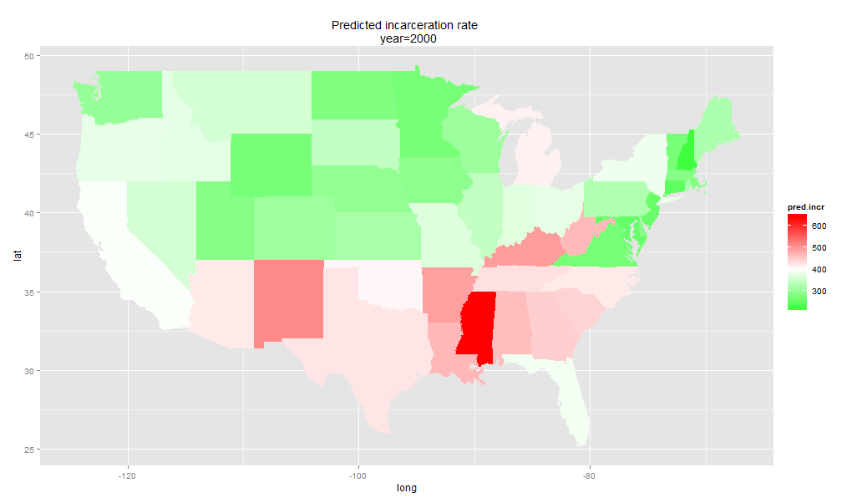
Actual vs Predicted incarceration rates for the year 2000
Actual
Predicted
The model was inaccurate for some states such as Virginia, West Virginia, Kentucky, Idaho, California and Nevada.
The model under predicted incarceration rates for Texas, which still seems ‘special’.

Slide 9
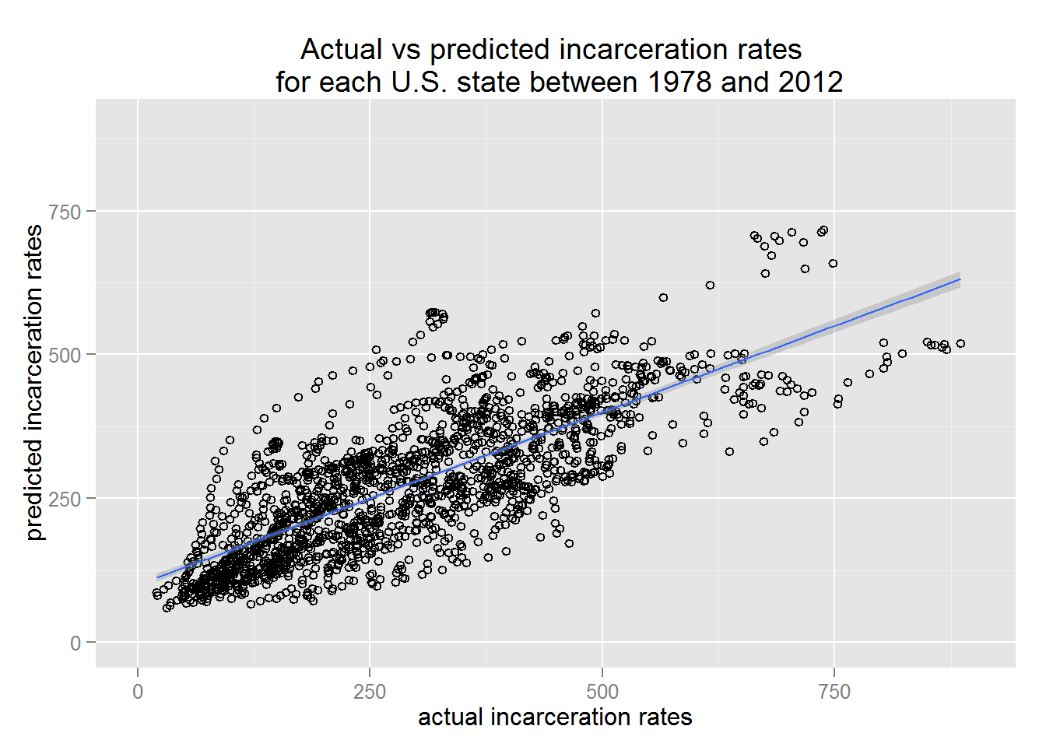
Validating the results.

Slide 10
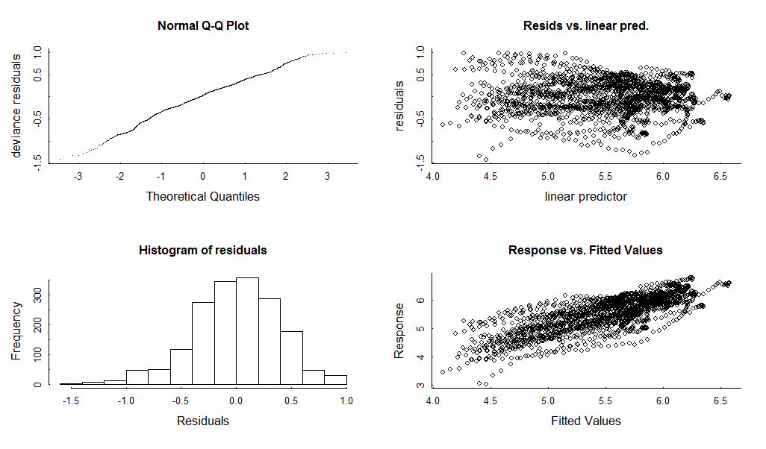
Some model diagnostics

Slide 11
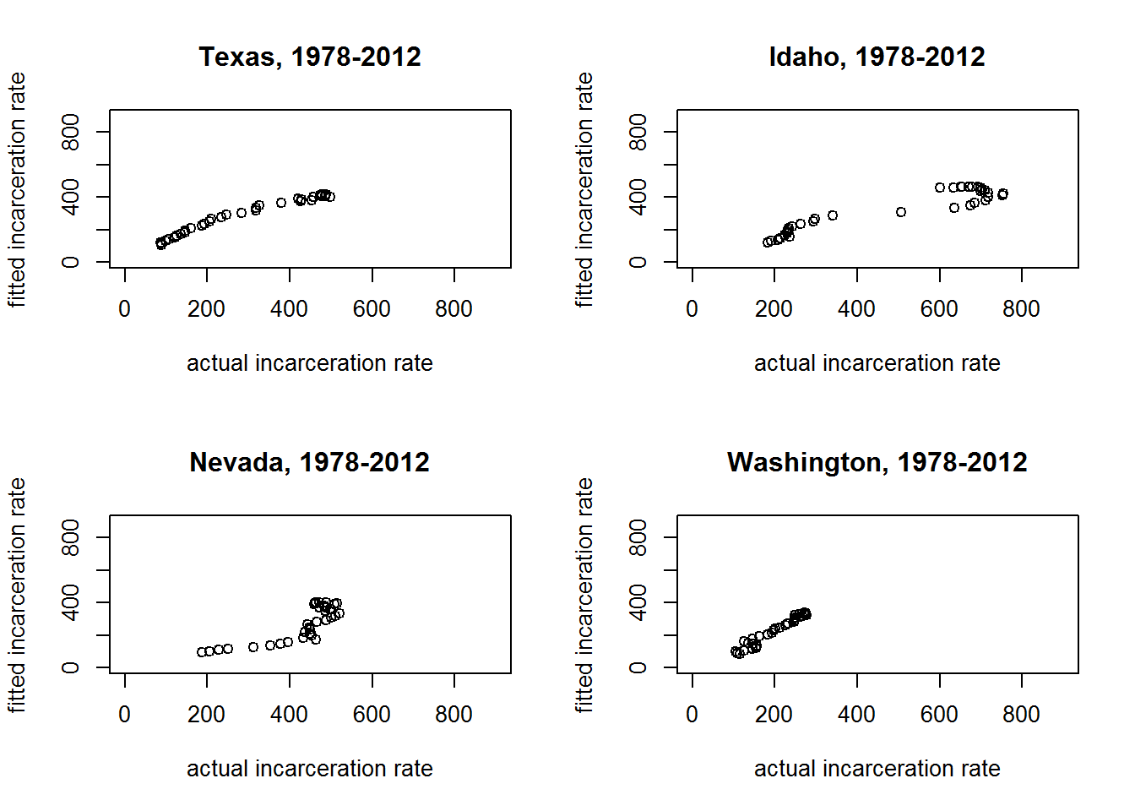
Plots of predicted vs actual for a few states

Slide 12
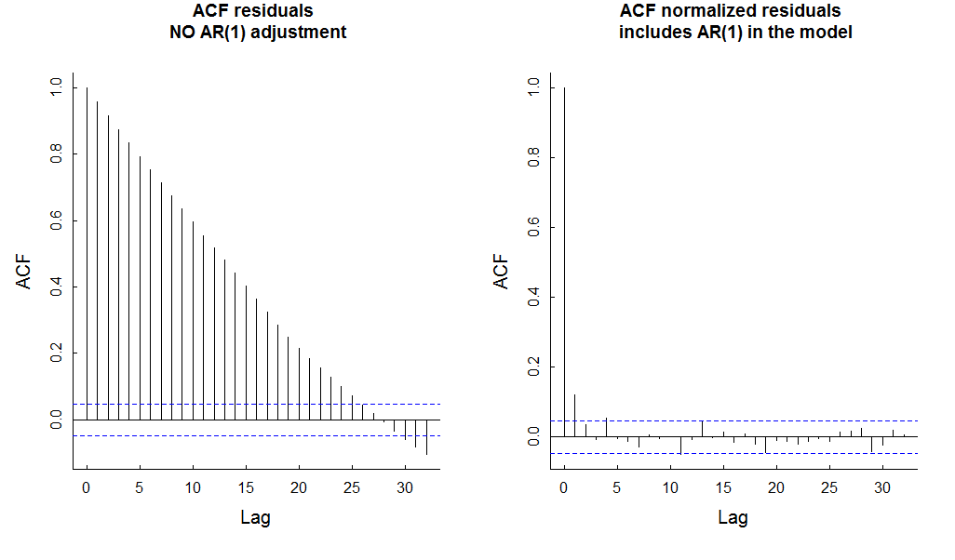
Model diagnostics: Adjusting for the time autocorrelation helped☺

Slide 13
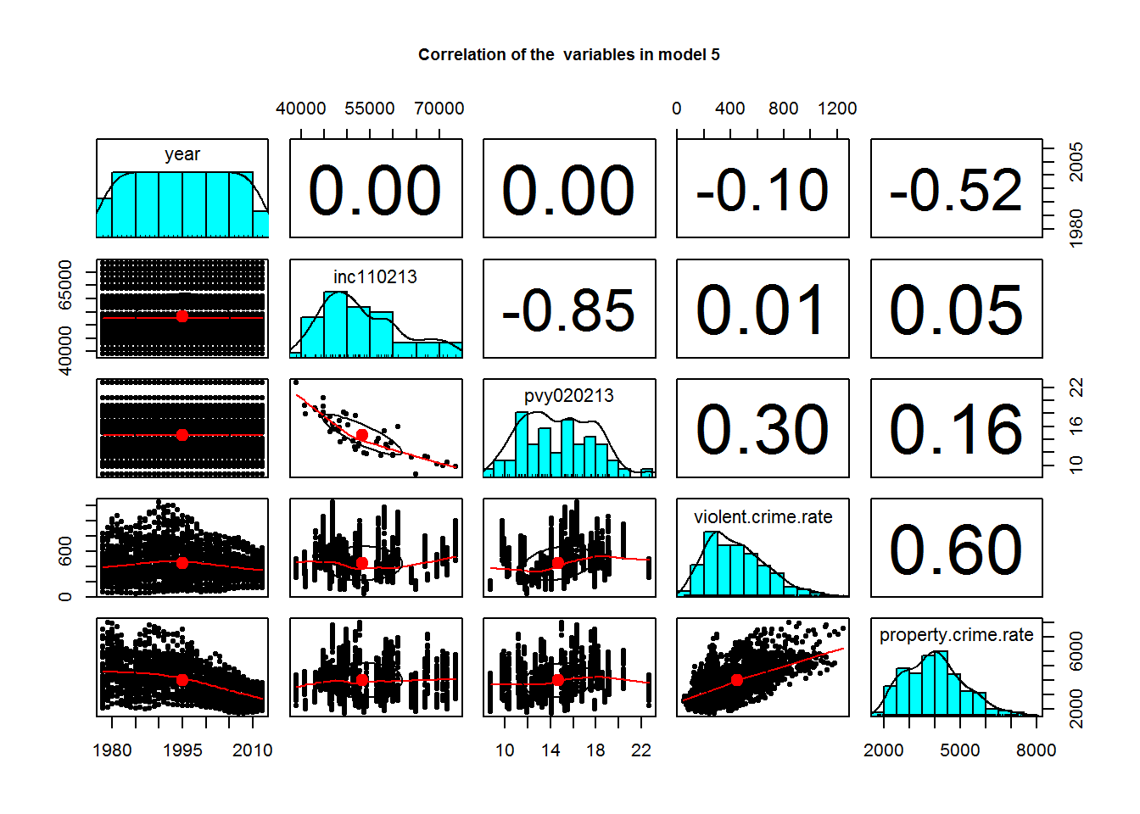
Correlations of the final variables + median income

Slide 14
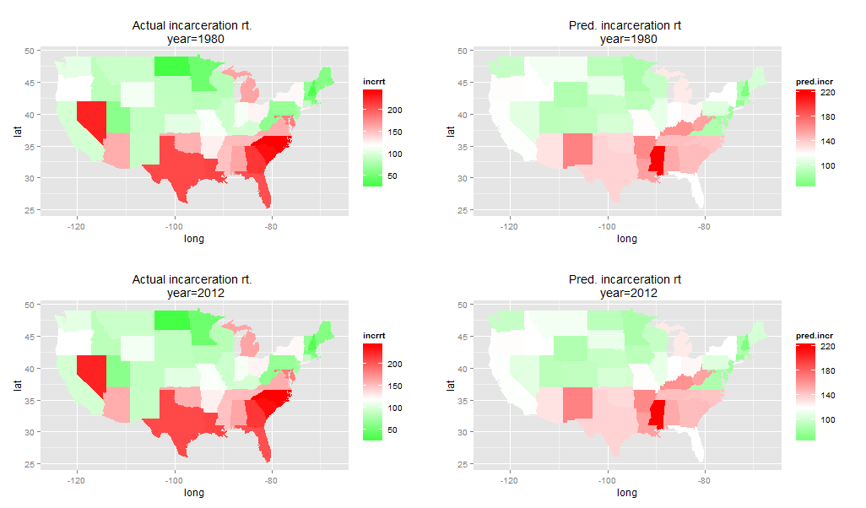
Actual vs Predicted incarceration rates for years 1980 and 2012

Slide 15
Summary
The percent of people living in poverty in a state was a better predictor of incarceration rates than crime rate.
Given that R^2 ~ 60% with these few variables, it would be interesting to get more data and develop the model even further.

Slide 16
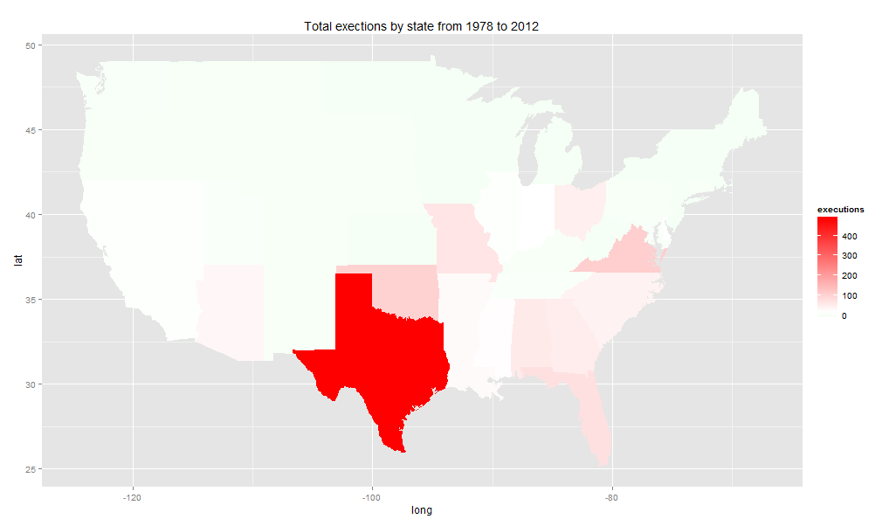
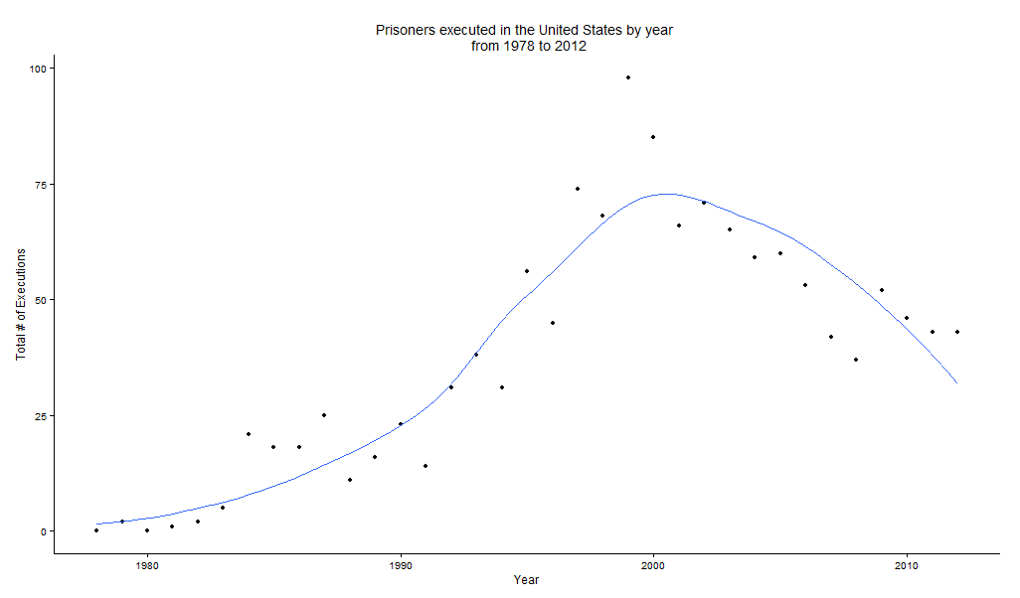
Appendix: Executions
Total executions by state from 1987 to 2012
Total executions by year from 1987 to 2012

